Slide 1
Facebook News Article analysis by Category for the first half of 2020
LIKEs, Shares, Comments
Emotional Reactions
Clickbait Status

Slide 2


Data Set
Buzzsumo website search for top performing news articles in 10 different categories.
10,000 Most popular news articles on Facebook and other social media during the past 6 months.
6 General categories - (Entertainment, Food, Health, Politics, Science, Sports)
4 Specific “Hot Button” categories during the first half of 2020. - (Covid, BLM, Trump, Biden)
10 .csv files were exported for each category and used for our analysis.

Slide 3

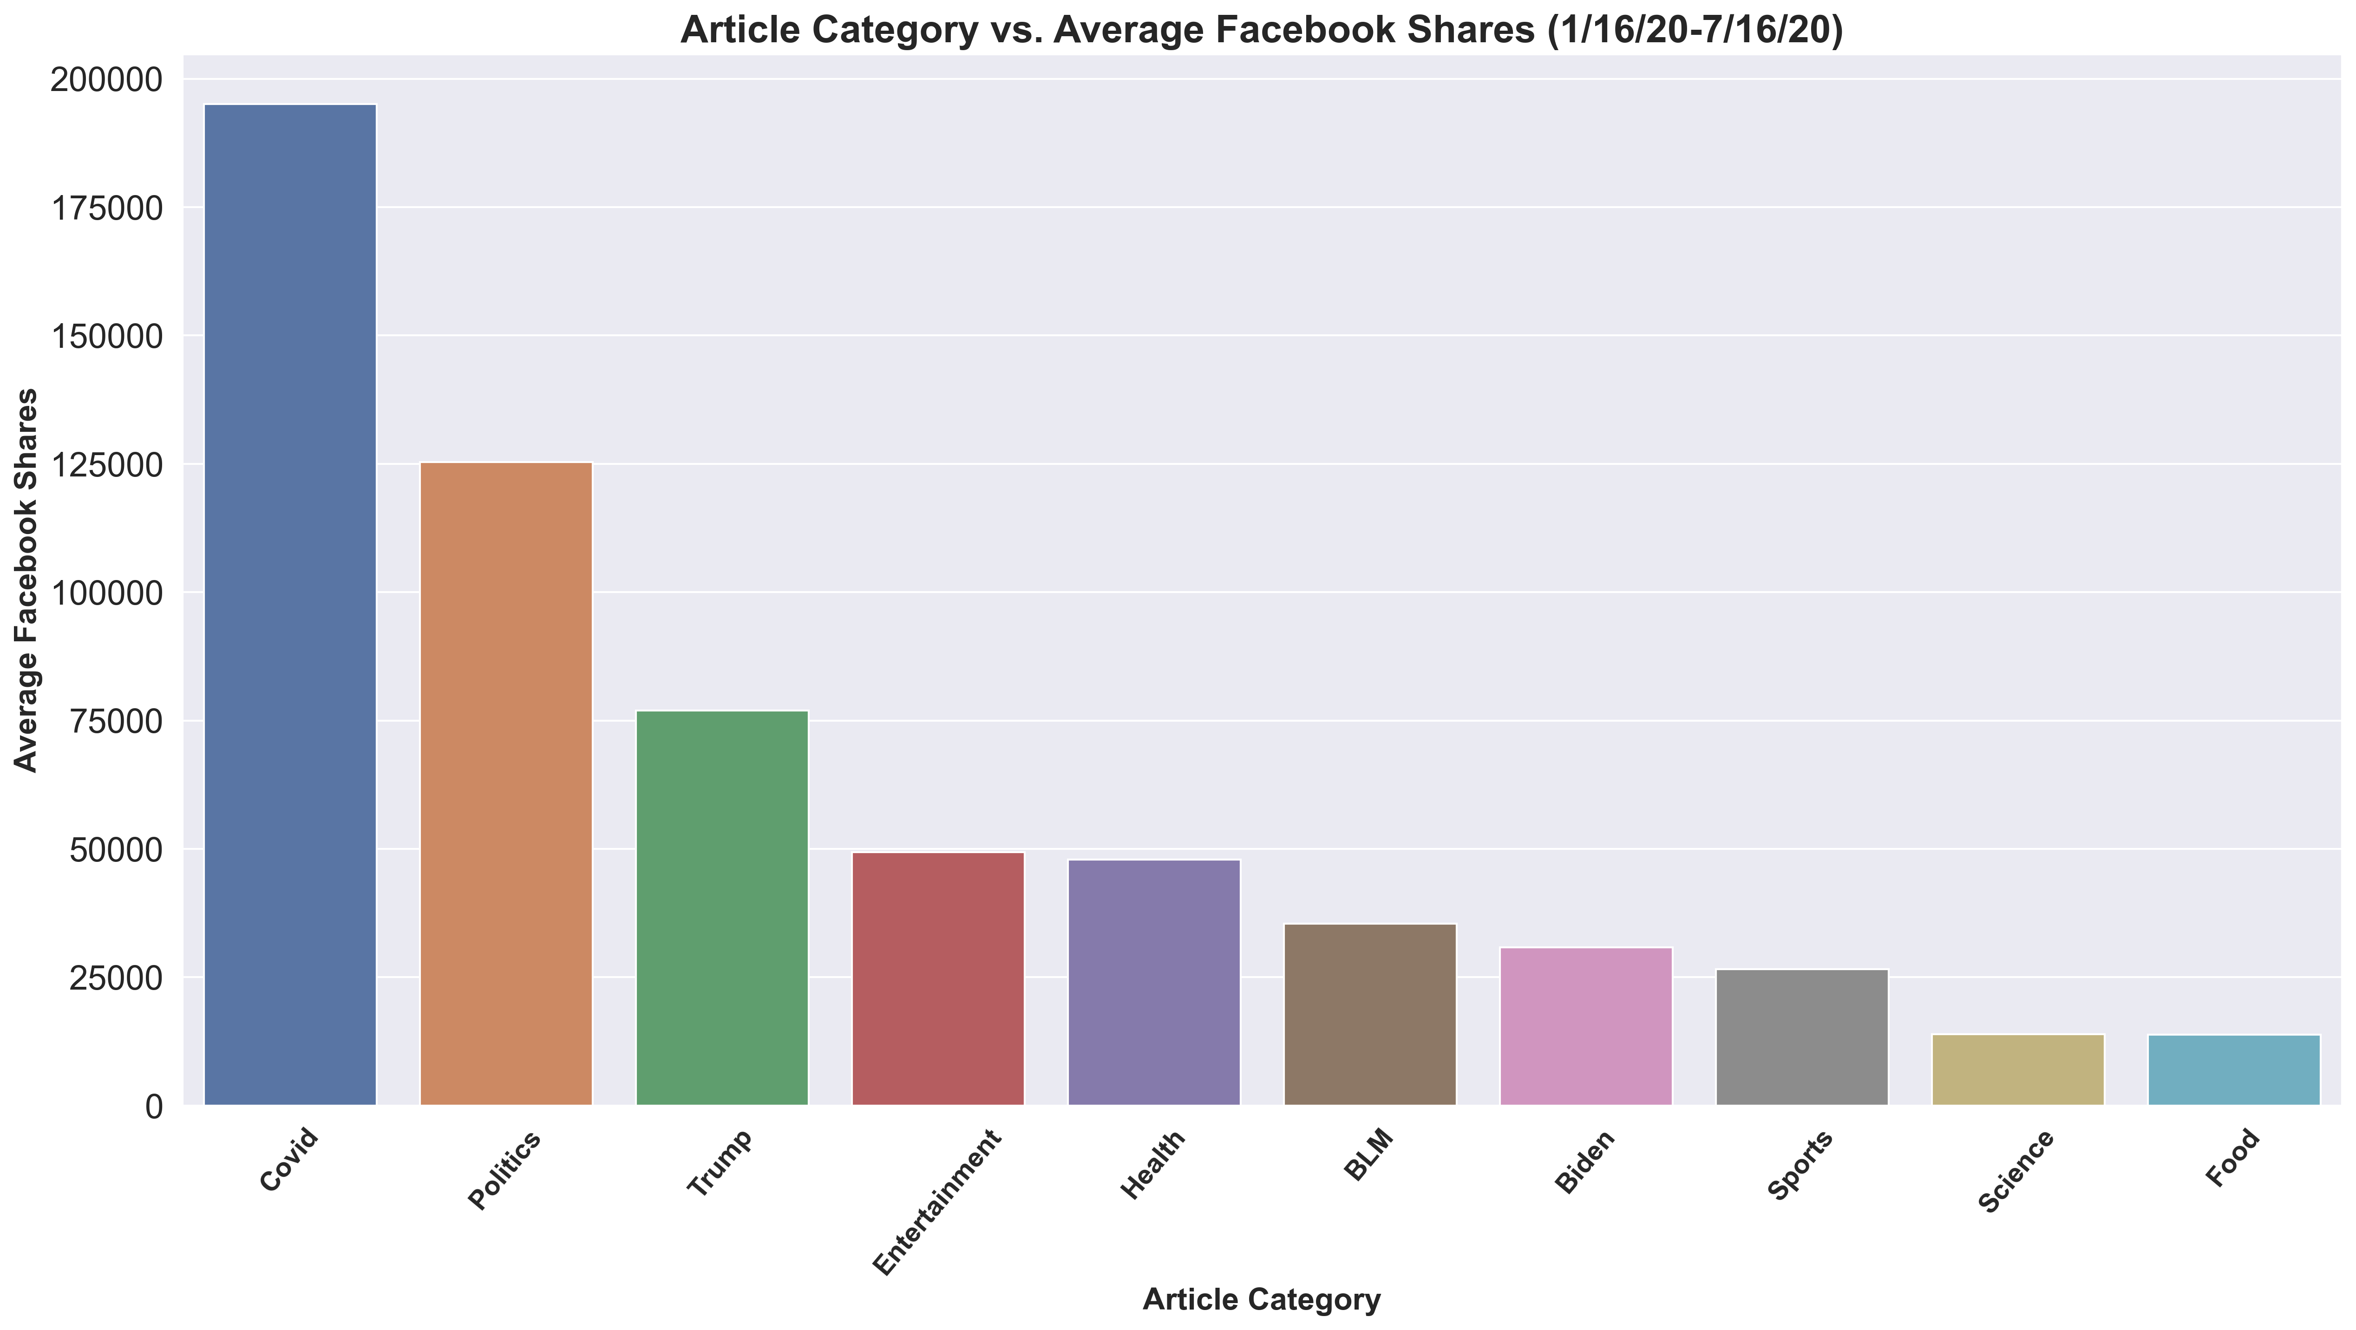
Overall Facebook Shares
Covid-19 Articles dominate the first half of 2020.
Trump has more than twice as many shares as Biden.
Entertainment is very popular.

Slide 4
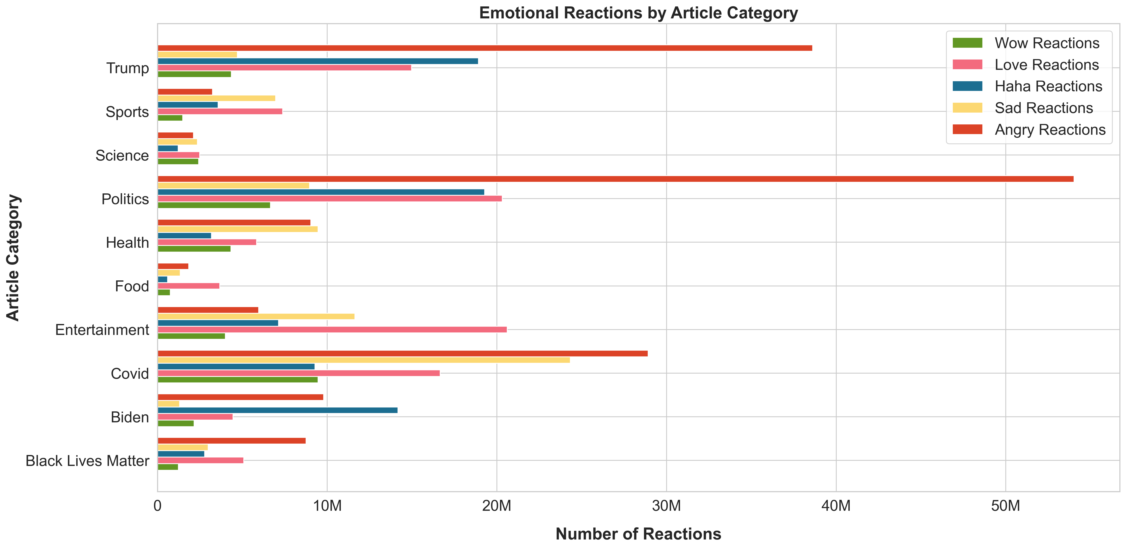


Slide 5
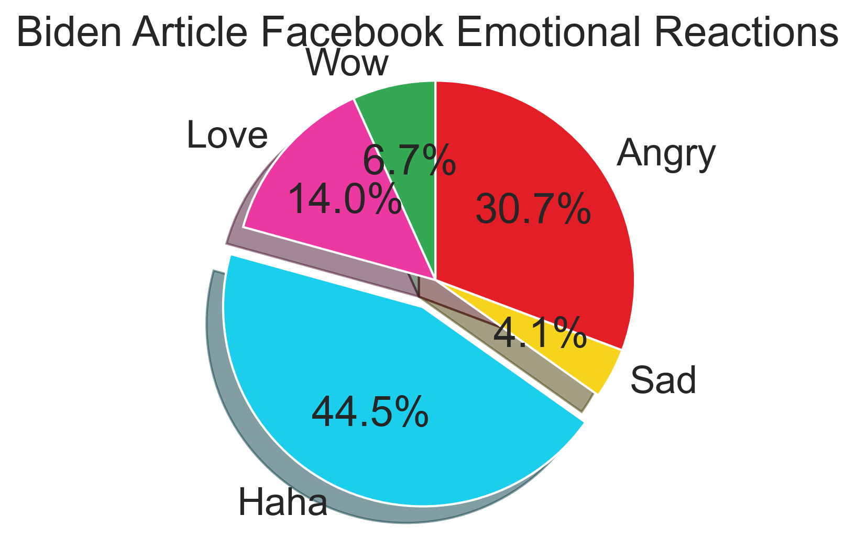
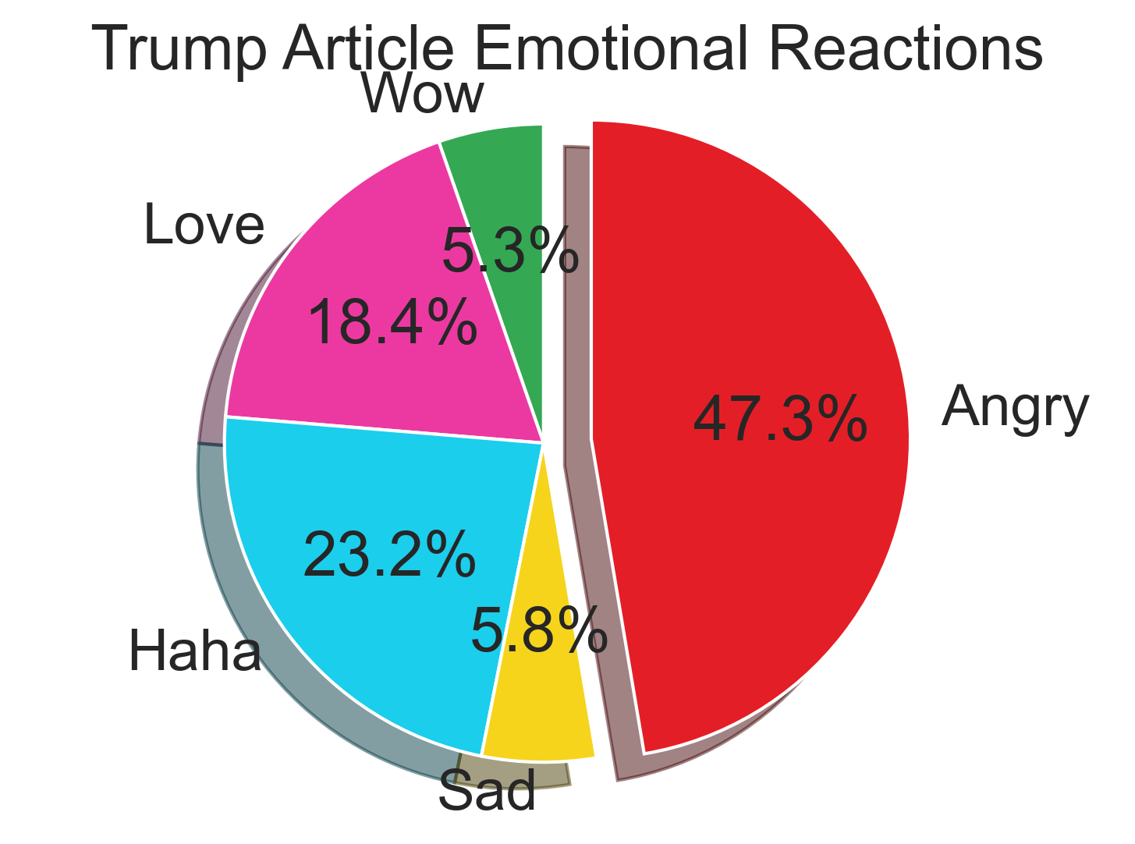
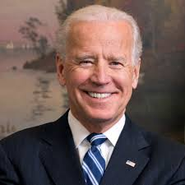

Biden vs. Trump emotional reactions

Slide 6

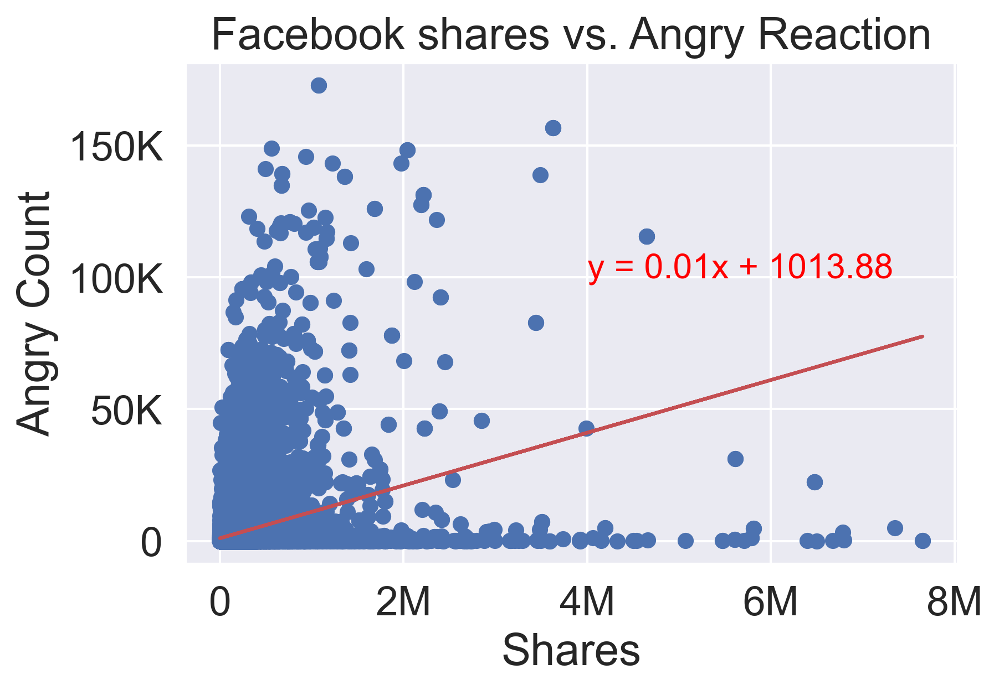
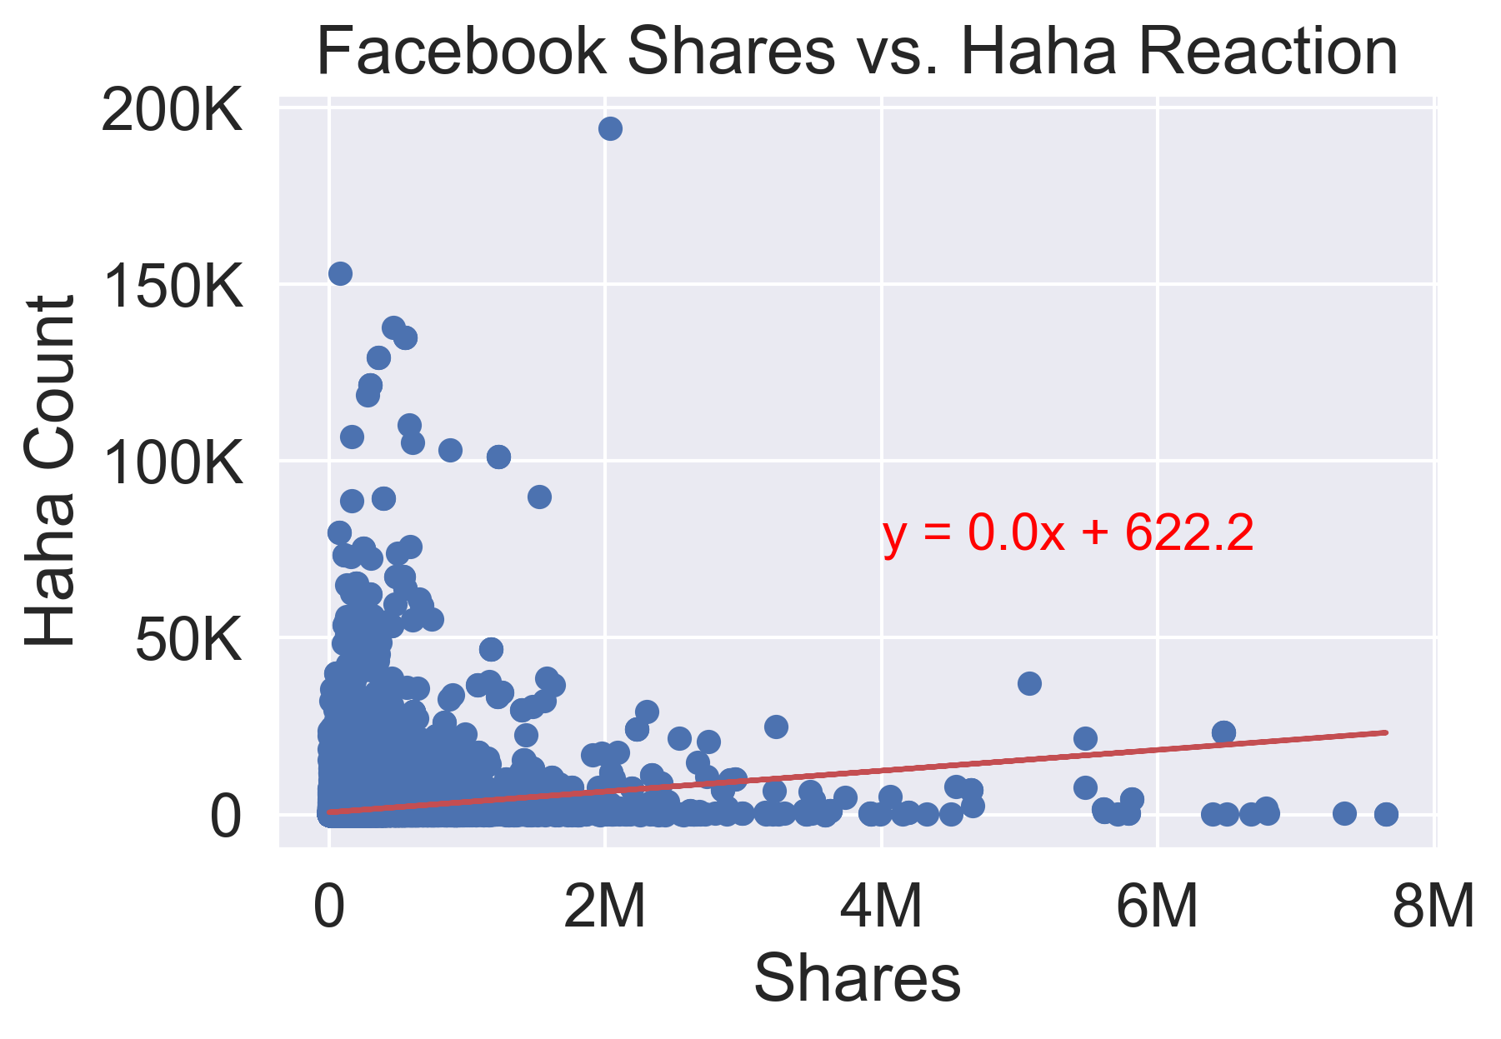
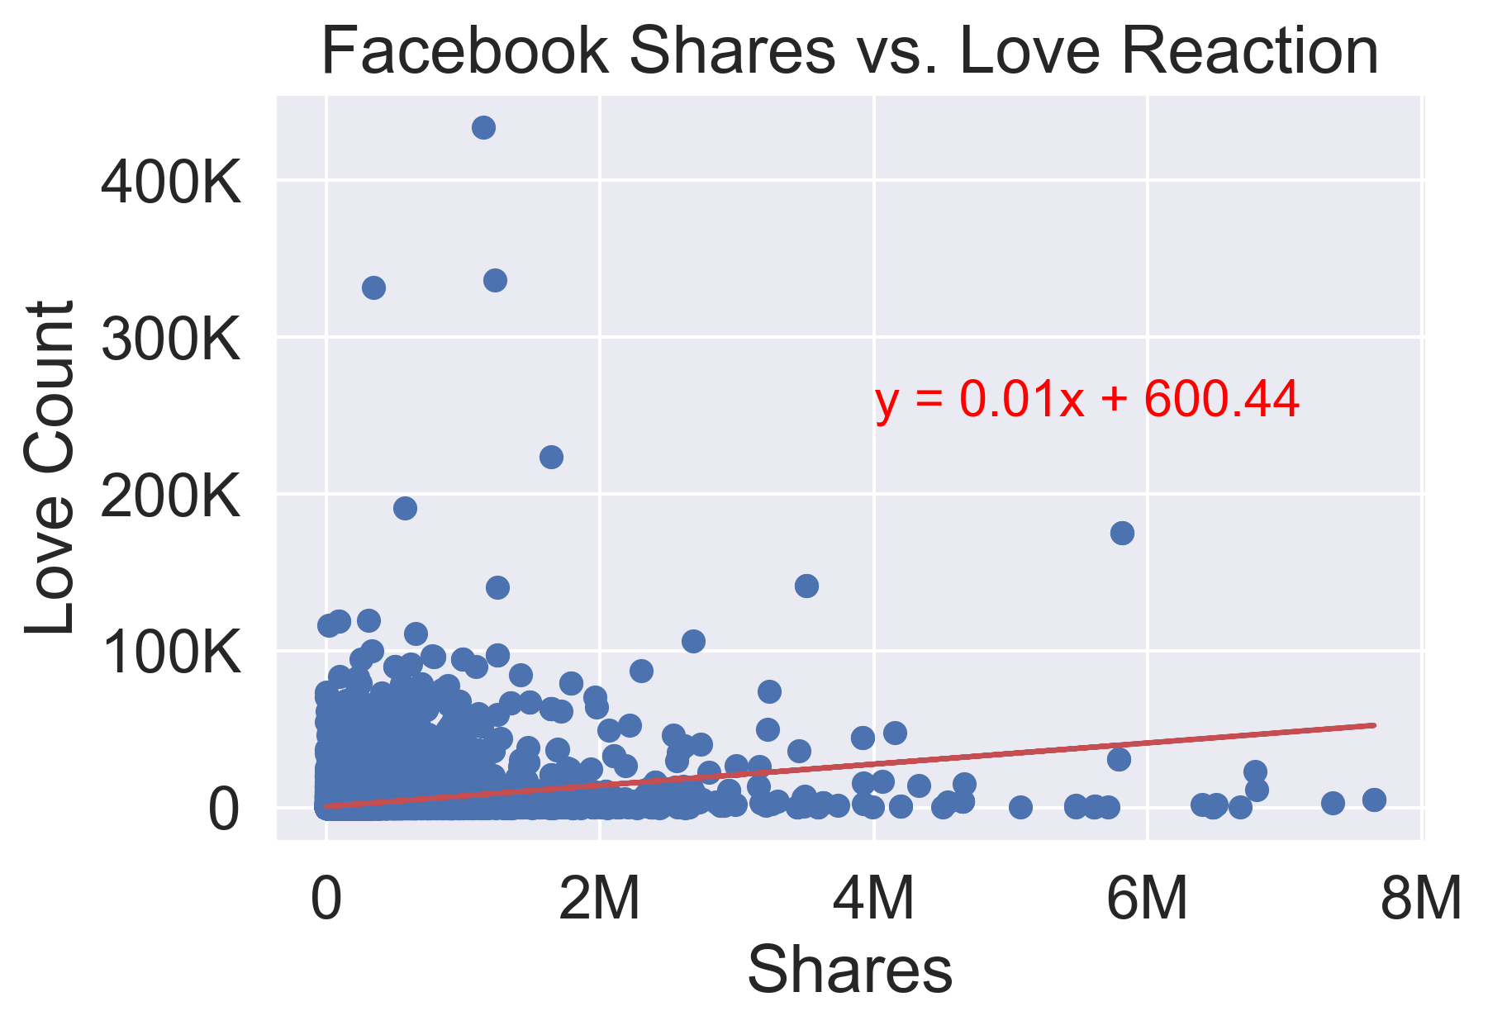



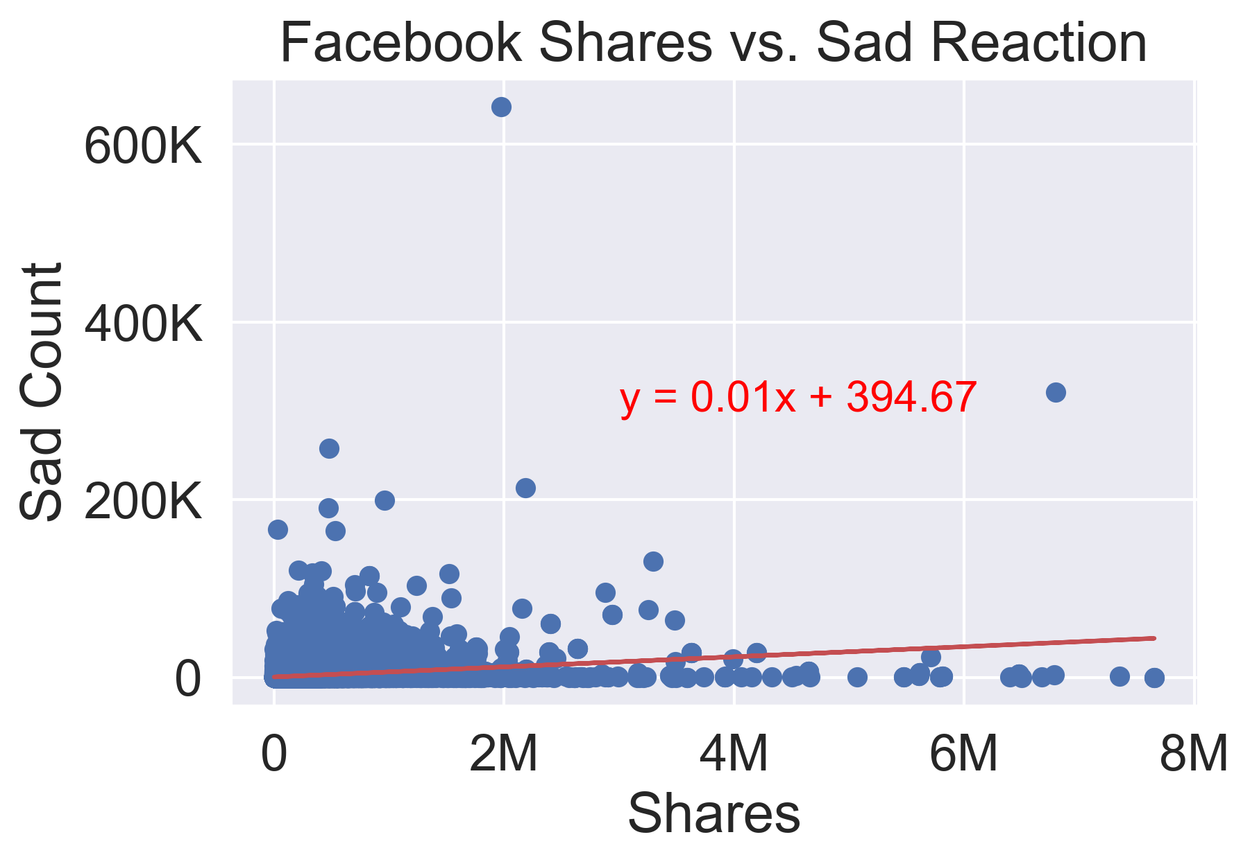
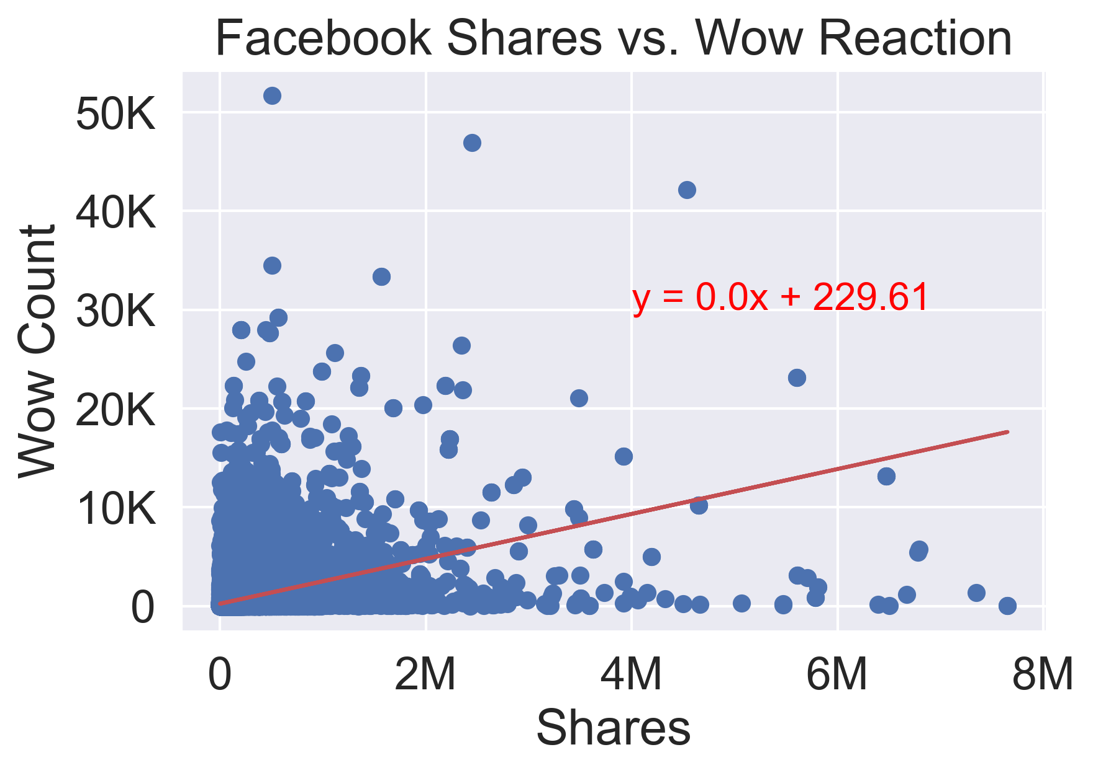


Facebook Article Shares Compared to Emotional Reactions.

